Slide 1
Common Pest Control Products
(most stringent PPE requirements)

Slide 2
Common Pest Control Products
(moderate PPE requirements)

Slide 3
Common Pest Control Products
(least stringent PPE requirements)

Slide 4
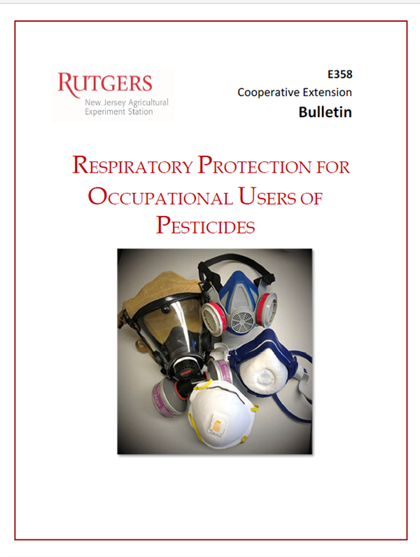
PPE: Respirators
For the best advice, go to the following link and apply that information to the specific product you intend to use.
https://njaes.rutgers.edu/pubs/publication.php?pid=E358
NIOSH and MSHA cross-referenced

